Slide 1
Xamarin Forms
What is Xamarin Forms?
What is Mvvm?
What is Xaml?
What is a Custom Renderer?
What is Dependency injection?

Slide 2
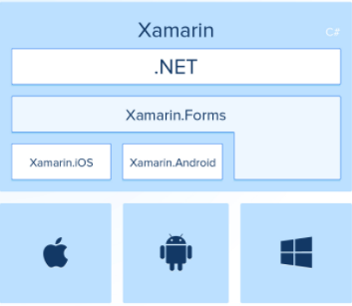
What is Xamarin Forms
Is a cross platform technology developed by Microsoft to create mobile applications using same code base across all platforms.
Approaches in Xamarin
Native (Xamarin Android or iOS)
Xamarin Forms
Basic architecture

Slide 3
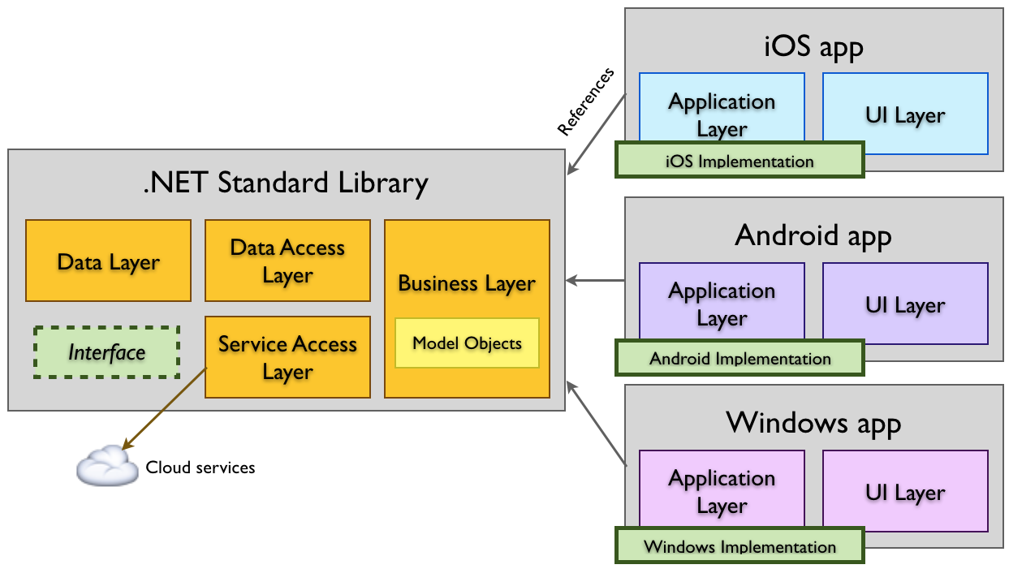
What is Xamarin Forms?
Basic architecture

Slide 4
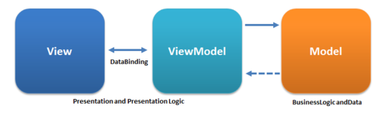
What is Mvvm?
Means Model–view–viewmodel is a software architectural pattern that facilitates the separation of the development of view from the development of the business logic so that the view is not dependent on any specific model platform

Slide 5
What is XAML?
Means eXtensible Application Markup Language
It is a variant of XML to describe GUI
Controls
Are views such Labels, Buttons and so on. That are defined in Xamarin Forms all controls derive from View
Data Binding
Is the technique of linking properties of two objects so that changes in one property are automatically reflected in the other property. Data binding is an integral part of the MVVM
BindableProperty
It is a keyword to define if a property are bindable.

Slide 6
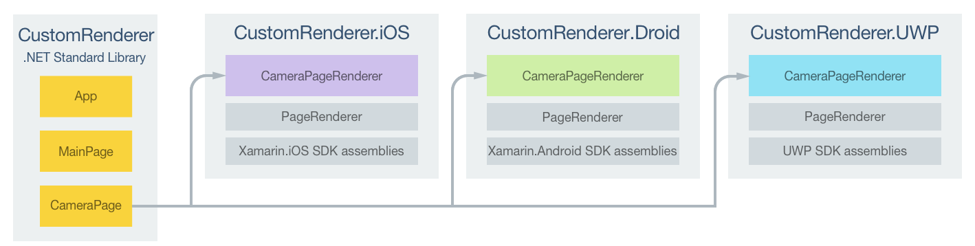
What is Custom Renderer?
Custom Renderers let developers override this process to customize the appearance and behavior of Xamarin. Forms controls on each platform

Slide 7
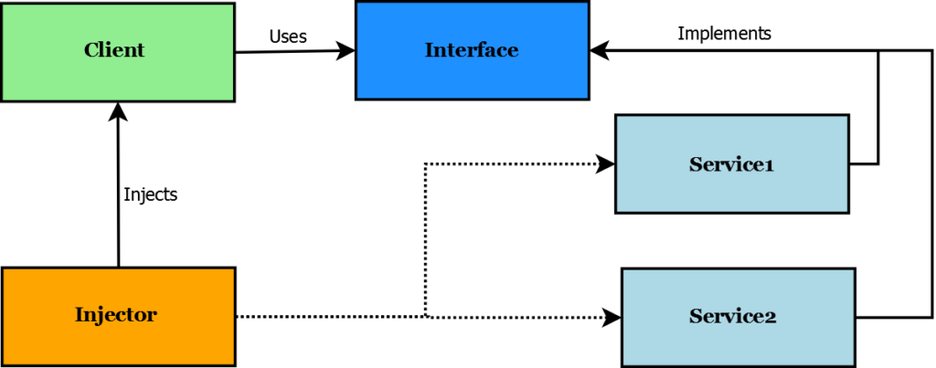
What is Dependency Injection?
Is the technique when an object received other object, the receiver object have a dependency, and the way we sent that object is the injection

